Slide 1
Making Your Project Indispensable
COE Staff
2014

Slide 2
TRIO as a Solution
President’s 2020 Goal – 1st in the World
Foundations – Lumina’s Big Goal
States – Governors’ College Access and Completion agendas
Institutions Mission
Corporate – 60% of jobs in 2018 require post-secondary credential/currently U.S. at 40%
Community Goals – school system, justice system
Notes:
We want projects to see themselves in a broader context than just one project at one institution or agency but rather a critical component to the success of the missions and goals set by institutions, state and local governments, their communities and school, foundations, industry, and national entities including the federal government.

Slide 3
Discussion
What are you currently doing to make your project indispensable?

Slide 4
Data
What kinds of data should you be using to show your project in indispensable?
High School Graduation
College Enrollment
Retention
Degree Attainment

Slide 5
Communication
What modes of communication should you be using to show your project is indispensable?
Newsletters
Social Media
Presentations
Meetings
Sitting on other committees/boards

Slide 6
Goals
What goals can be accomplished by making your project indispensable?
Serve more students
Open up additional funding streams
Create collaborations
Better position at your institution

Slide 7
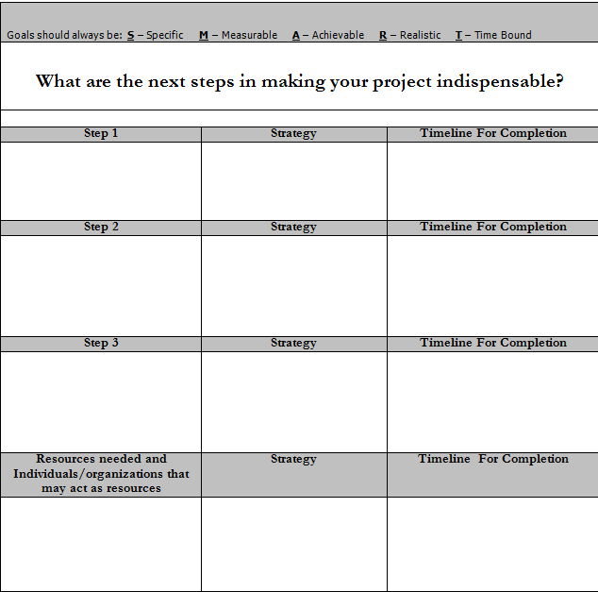
Action Plan

Slide 8
Resources
Your Institution’s Mission Statement
COE Media Toolkit
http://www.coenet.us/files/pubs_reports-The_TRIO_Media_Relations_Handbook.pdf
COE Publications and Reports
http://www.coenet.us/coe_prod_imis/COE/Newsroom/Publications_and_Reports/COE/NAV_Newsroom/Publications_and_Reports.aspx?hkey=070d23cc-739f-47e5-8cb8-d8ed82f97d0a
COE Bulletin Board
http://www.coenet.us/coe_prod_imis/COE/Issues/Bulletin_Board/COE/NAV_Issues/Bulletin_Board.aspx?hkey=a15a4459-c716-47fb-8bf8-4f342b0c4e50
Lumina Big Goal
http://www.luminafoundation.org/goal_2025.html
State Policy Tracking
http://www.ncsl.org/research/telecommunications-and-information-technology/ncsl-50-state-searchable-bill-tracking-databases.aspx

